Slide 1

Custom MVC Controllers
Drew Zarn
Systems Architect
Professional Assist Corporation

Slide 2
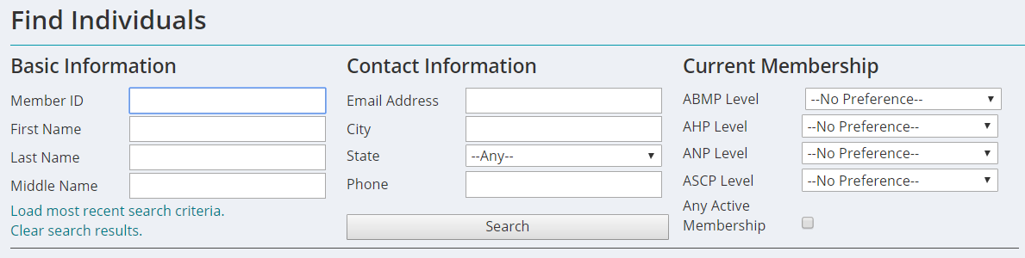
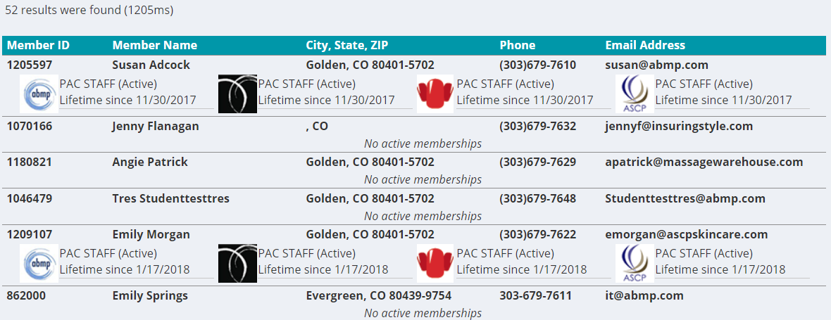
Find 2.0

Slide 3
But WHY?
Speed
Quicker to select single membership dropdown, no postbacks
Search itself is significantly faster (500-1000ms vs ~4 seconds)
Single results auto-load the individual/org profile
Search customizations
Focus on the fields we use most to search
ID search from (almost) any iWeb page

Slide 4
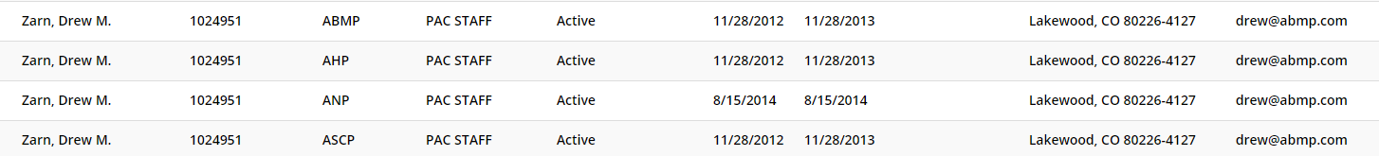
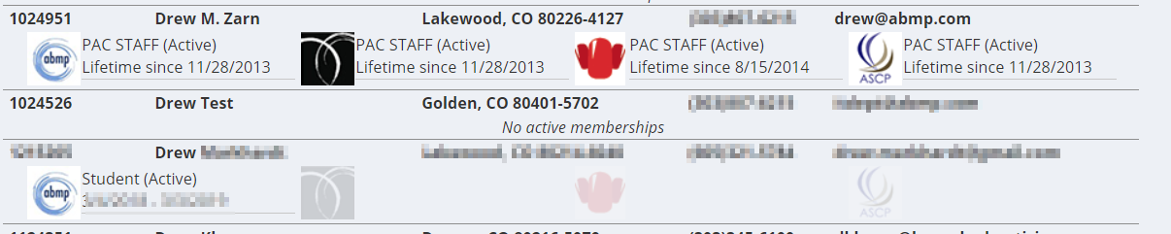
Usability of results
Multiple associations/memberships means multiple rows:
Vs 1 row with all associations & icons:

Slide 5
Wait…this isn’t the toolkit
Custom controllers give WAY more flexibility, and are super easy to implement
At a minimum, you need a DLL and a CSHTML view
Probably also want a CSS & JS file for looks & client-side functionality

Slide 6
C# code
Use System.Web.Mvc, and extend Avectra.netForum.BaseUI.BaseController
DynamicPageModel model = new DynamicPageModel("<dynKey of object profile form>", "");
This gives you the right navigation
ActionResult will load a view:
return base.View(model);
JsonResult to return JSON
Don’t forget to allow gets! return Json(objToReturn, JsonRequestBehavior.AllowGet);

Slide 7
View
Uses Razor syntax (https://docs.microsoft.com/en-us/aspnet/web-pages/overview/getting-started/introducing-razor-syntax-c)
Copy iWeb\Views\Shared\_Layout.cshtml to _ClientLayout.cshtml
Strip out UserCanEdit and HistoryMode stuff, fix CSS/JS paths (~ instead of ..)
Include some layout to get into the iWeb framework: <div id="ContentPane"><div class="mainDiv">YOUR STUFF GOES HERE!</div><div>

Slide 8
Pesky little details
Your controller name & action define the URL and folder structure
Using PrettyAwesomeController and the BeAwesome action…
URL is /iweb/forms/PrettyAwesome/BeAwesome
View is at iweb\Views\PrettyAwesome\BeAwesome.cshtml
CSS & JS can live wherever, but for consistency:
Assets\Styles\PrettyAwesome.css
Assets\Scripts\PrettyAwesome.js

Slide 9
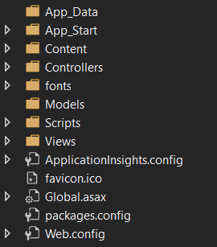
Project setup
Create an ASP.NET Web Application (.NET Framework) in Visual Studio
Select the MVC template
Nuke all except Controllers, Models, Views
Add references to (at least) BaseUI, Common, and iWeb DLLs
Add your controller CS and view CSHTML files
Make it do things!

Slide 10
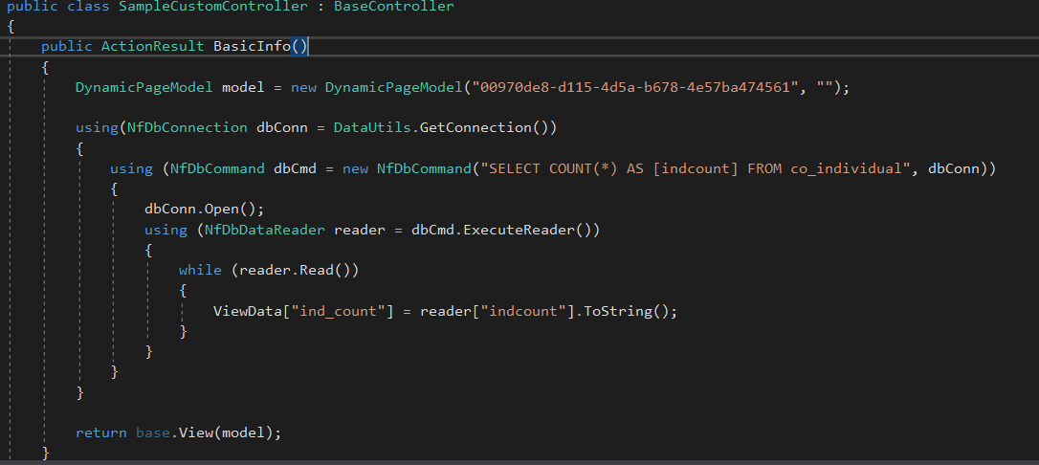
Controller
There’s a custom MVC sample at https://github.com/professional-assist-corp/iWeb-MVC-Sample

Slide 11
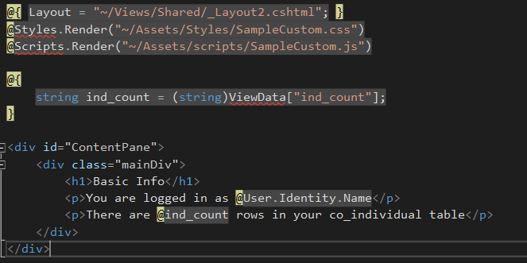
View

Slide 12
Gotchas
By default, JSON GET requests aren’t allowed. Have to include JsonRequestBehavior.AllowGet when returning Json()
Request size limits include viewstate, which can give random, impossible-to-replicate errors
Currently no way to customize the URL
DLL Hell is still a thing. Delete the System.Web.Mvc reference, and re-add a reference using that DLL from your iweb\bin folder so the version matches (currently 5.0.0.0 in 2017.1.5.3)
Have to do this with any DLL included in baseline. Newtonsoft, etc

